Slide 1



Sql Project
View in Power BI
Last data refresh:
10/18/2023 7:48:03 AM UTC
Downloaded at:
10/18/2023 8:10:03 AM UTC

Slide 2
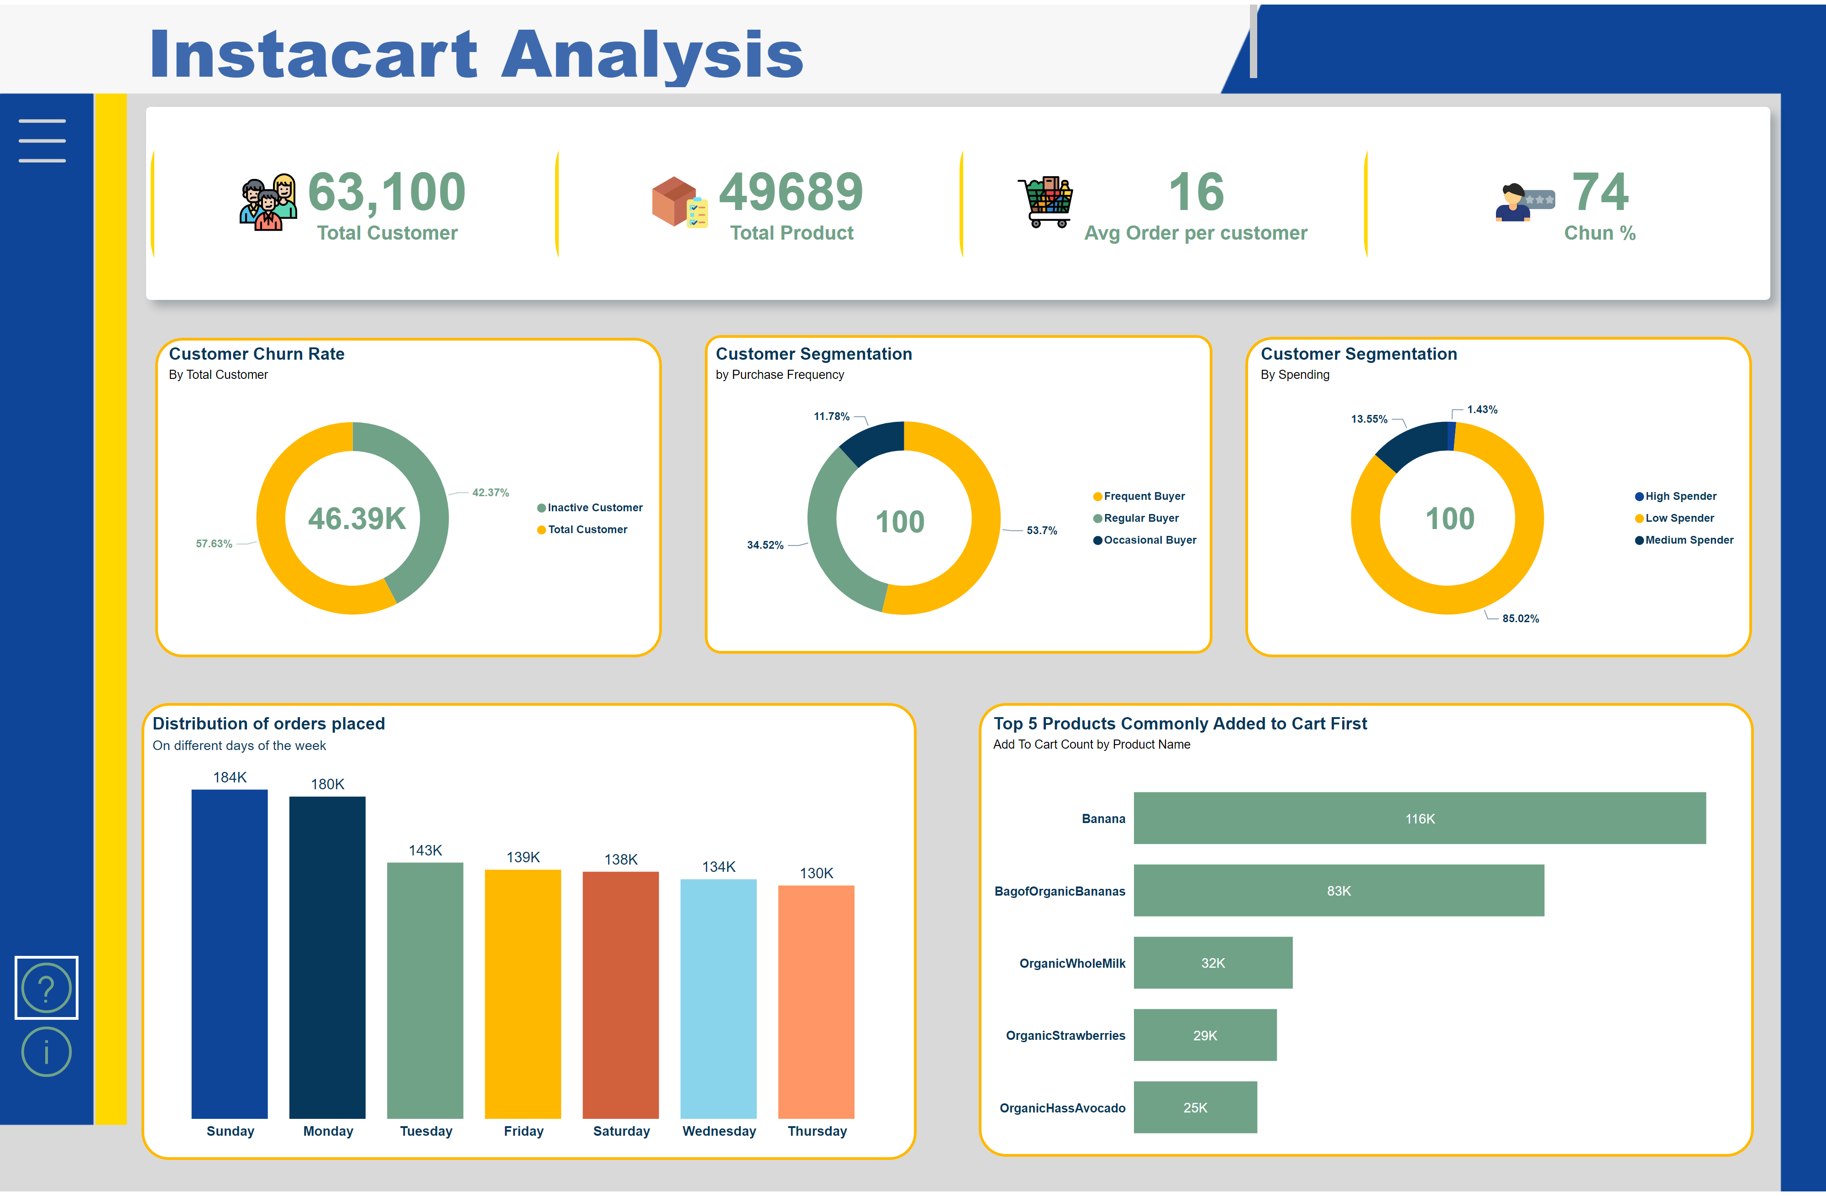
👨‍💼BUSINESS OVERVIEW
Notes:
cardVisual
No alt text provided
shape
No alt text provided
shape
No alt text provided
shape
No alt text provided
shape
No alt text provided
Top 5 Products Commonly Added to Cart First
No alt text provided
Customer Segmentation
No alt text provided
Distribution of orders placed
No alt text provided
Customer Segmentation
No alt text provided
Customer Churn Rate
No alt text provided
HELP
No alt text provided
INFO
No alt text provided
MENU
No alt text provided
actionButton
No alt text provided
actionButton
No alt text provided
actionButton
No alt text provided
shape
No alt text provided
actionButton
No alt text provided
card
No alt text provided
card
No alt text provided
card
No alt text provided
textbox
No alt text provided
shape
No alt text provided

Slide 3
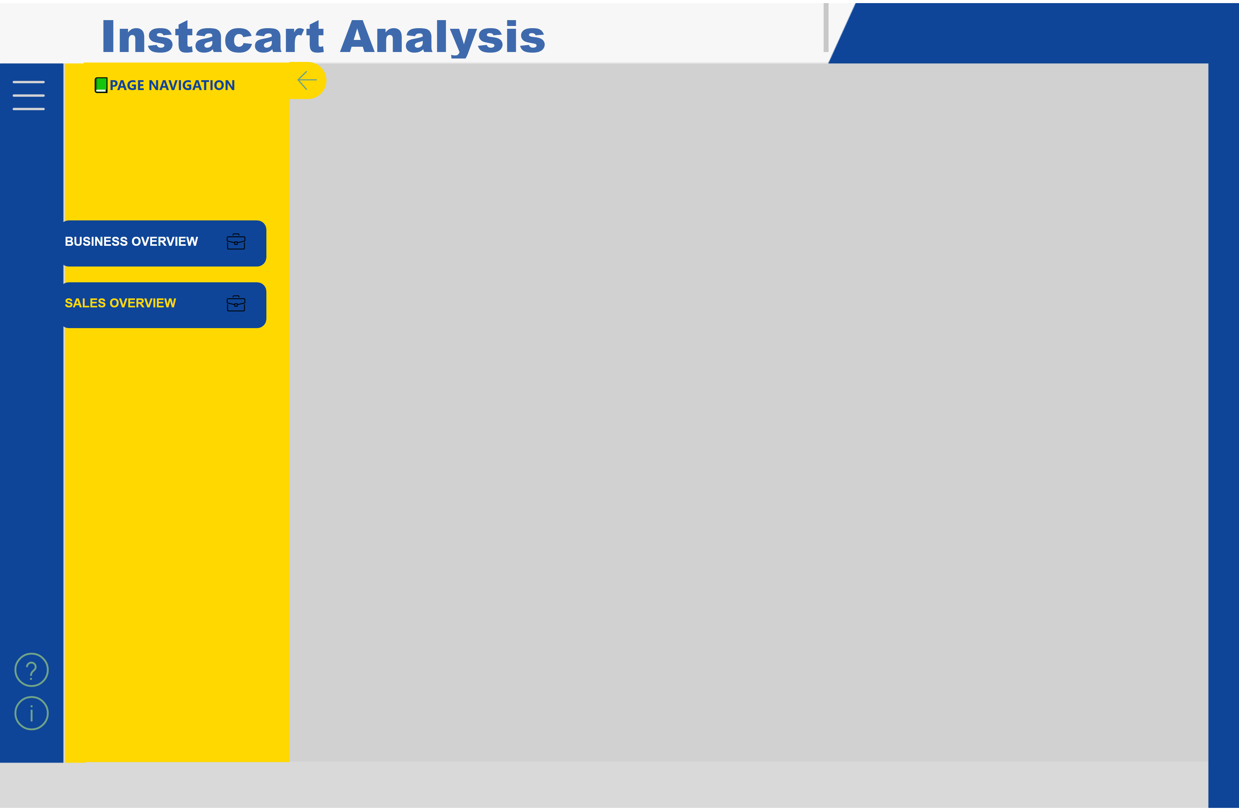
🔖SALES OVERVIEW
Notes:
cardVisual
No alt text provided
shape
No alt text provided
shape
No alt text provided
shape
No alt text provided
textbox
No alt text provided
shape
No alt text provided
shape
No alt text provided
donutChart
No alt text provided
columnChart
No alt text provided
donutChart
No alt text provided
donutChart
No alt text provided
HELP
No alt text provided
INFO
No alt text provided
MENU
No alt text provided
BUSINESS
No alt text provided
SALE
No alt text provided
CLOSE
No alt text provided
PAGE NAVIGATION
No alt text provided
BLOCKCLICK
No alt text provided
shape
No alt text provided
funnel
No alt text provided
funnel
No alt text provided
tableEx
No alt text provided
shape
No alt text provided
textbox
No alt text provided
shape
No alt text provided
shape
No alt text provided
sankey02300D1BE6F5427989F3DE31CCA9E0F32020
No alt text provided

Slide 4
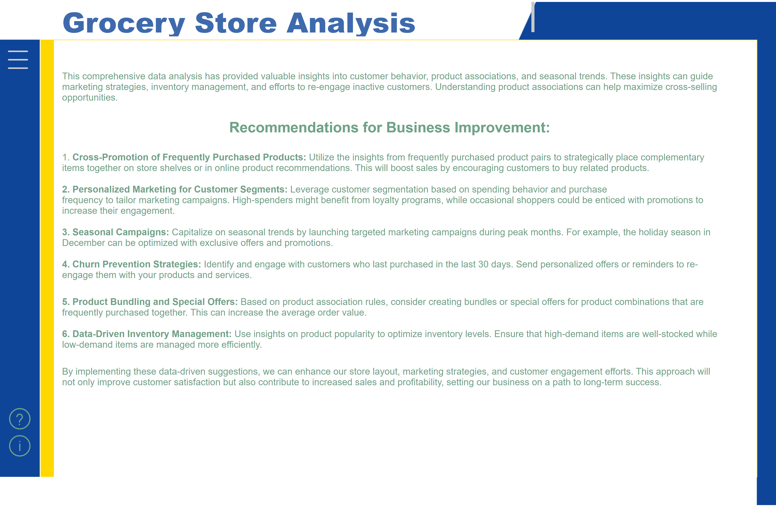
ℹ INFORMATION
Notes:
cardVisual
No alt text provided
shape
No alt text provided
shape
No alt text provided
shape
No alt text provided
textbox
No alt text provided
shape
No alt text provided
shape
No alt text provided
clusteredBarChart
No alt text provided
donutChart
No alt text provided
columnChart
No alt text provided
donutChart
No alt text provided
donutChart
No alt text provided
HELP
No alt text provided
INFO
No alt text provided
MENU
No alt text provided
actionButton
No alt text provided
actionButton
No alt text provided
actionButton
No alt text provided
shape
No alt text provided
actionButton
No alt text provided
textbox
No alt text provided
textbox
No alt text provided

